Slide 1

None So Blind
An Examination of What Is Said about the Scriptures vs. What is Written There
A Watchman at the Gate Call
to Put Aside Tradition
In Exchange for What is Written
By Barbara L. Klika, MSW
Undershepherd
Set Apart Ministries
May, 2012

Slide 2

Abba Father, please teach us what YOU want us to know!
In our Messiah Yeshua’s Name we ask!
May it be so!

Slide 3
Common Sayings
There are none so blind as those who will not see.
Idiom
Hearing is believing.
Scriptural Principle
Our physical senses ARE important in a physical world.

Slide 4
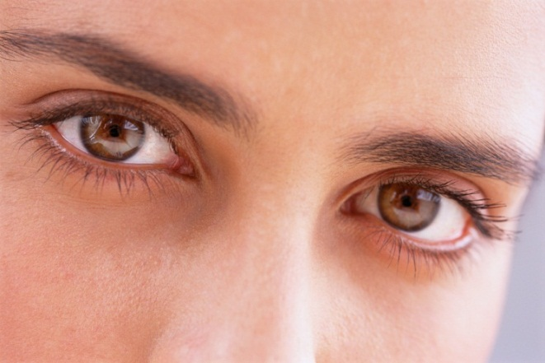
Seeing and Hearing
Idiom
Possible Original Source
There are none so blind as those who will not see.
Hear now this,
O foolish people,
and without understanding;
which have eyes, and see not; which have ears, and hear not:
Jeremiah 5:21

Slide 5
Double Meanings
Blind -- Typhlos
See -- Blepo
Strong’s # 5185
Can refer to both blindness of the eyes and of the mind or the spirit.
From a root word, tophoo “to wrap in a mist” and can mean to be blinded with pride.
Strong’s # 991
Can refer to both physical seeing and to mind’s eye or discernment.
To perceive by the senses, to feel, or to discover by use, to know by experience.

Slide 6
Ignoring What Is Seen:
Excerpts from John 9 NKJV
He answered and said, A man called Jesus made clay, and anointed my eyes, and said to me, Go to the pool of Siloam, and wash. So I went and washed, and I received sight.
Then said they to him, Where is he? He said, I do not know.
They brought him who was formerly blind to the Pharisees.
Now it was a sabbath day when Jesus made the clay and opened his eyes.
Then the Pharisees also asked him again how he had received his sight. He said to them, “He put clay on my eyes, and I washed, and I see.”

Slide 7
Therefore some of the Pharisees said, “This man Is not from God, because he does not keep the Sabbath.” Others said, How can a man who is a sinner do such signs? And there was a division among them.
They said to the blind man again,” What do you say about him, because he opened your eyes? “ “He said, He is a prophet.”
But the Jews did not believe concerning him, that he had been blind, and received his sight, until they called the parents of him that had received his sight.

Slide 8
His parents were reluctant to admit they knew anything! They were afraid of being put out of the assembly if they confessed they thought Yeshua was Messiah.
So the leaders again called the man to ask him, declaring that the one who healed him must be a sinner. The man said he only knew that he was blind and now could see! So they asked him yet again!

Slide 9
Did He Know What He Was Saying!!
He answered them, “I told you already, and you did not listen. Why do you want to hear it again? Do you also want to become His disciples?”
Then they reviled him, and said, “You are his disciple, but we are Moses’ disciples. We know that God spoke to Moses; as for this fellow, we do not know where he is from.”

Slide 10
The man answered and said to them, Why this is a marvellous thing, that you do not know where He is from, yet he has opened my eyes! Now we know that God does not hear sinners, ; but if anyone is a worshipper of God, and does his will, He hears him.
Since the world began it has been unheard of that anyone opened the eyes of one who was born blind. If this man were not from God, he could do nothing.”
They answered and said to him, “You were completely born in sins, and are you teaching us? And they cast him out.

Slide 11
Yeshua Confirmed His Identity and His Judgment
And Jesus said, For judgment I am come into this world, that they which see not might see; and that they which see might be made blind.
And some of the Pharisees which were with him heard these words, and said to him, “Are we blind also?”
Jesus said unto them, “If you were blind, you should have no sin; but now you say, We see; therefore your sin remains.”

Slide 12
Commentary
"There are none so blind as those who will not see.
The most deluded people are those who choose to ignore what they already know.
The proverb has been traced back in English to 1546 (John Heywood), and resembles the Biblical verse quoted (above). In 1738, it was used by Jonathan Swift in his 'Polite Conversation,' and is first attested in the United States in the 1713 'Works of Thomas Chalkley'..."

Slide 13
Which “Tree” is More Appealing?

Slide 14
No longer seeing
But able to hear…
Deceived,
They Became
Poor, Blind and Naked

Slide 15
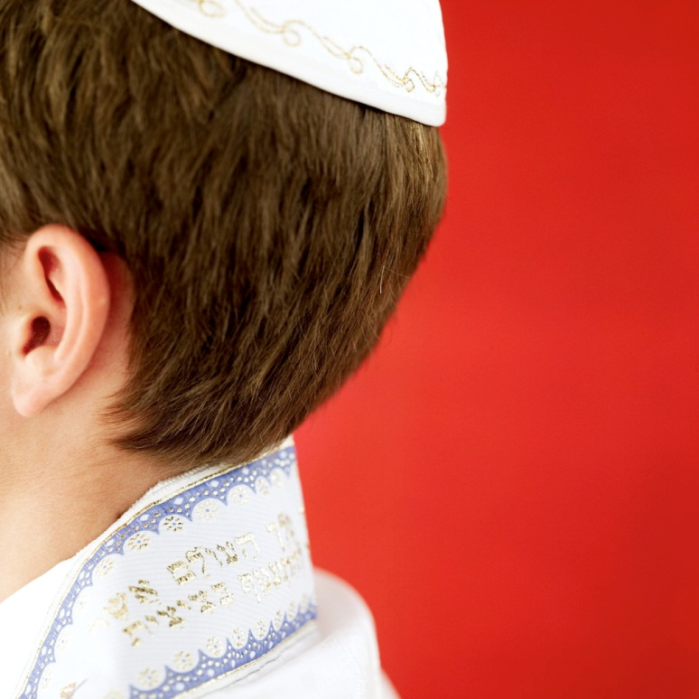
Hearing is Believing
So then faith comes by hearing, and hearing by the word of God.
Romans 10:17
Who was Eve listening to?
How will we choose to use our senses?

Slide 16
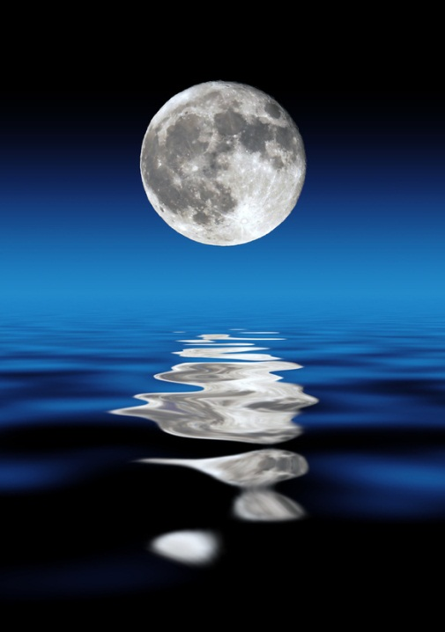

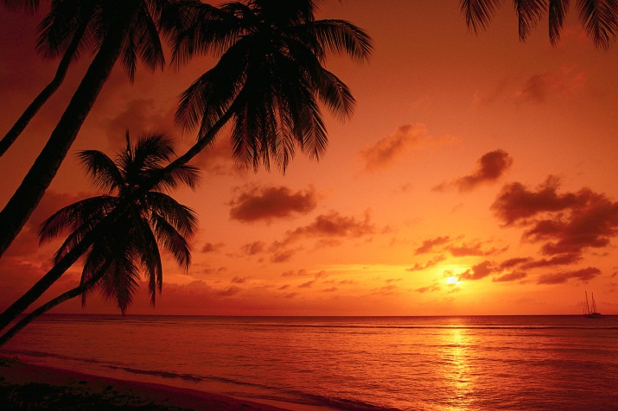
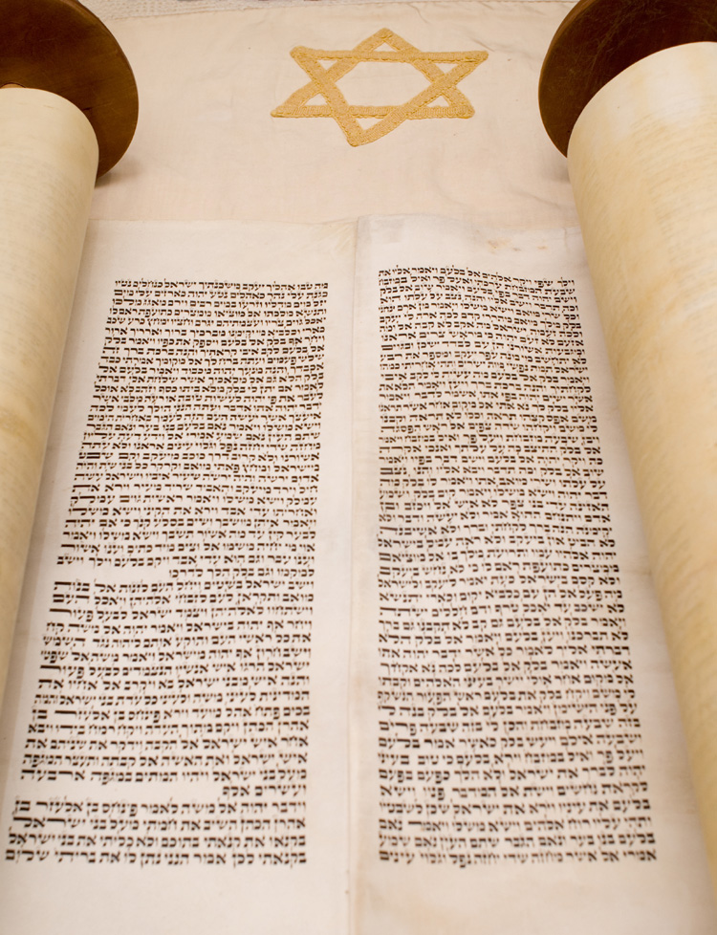
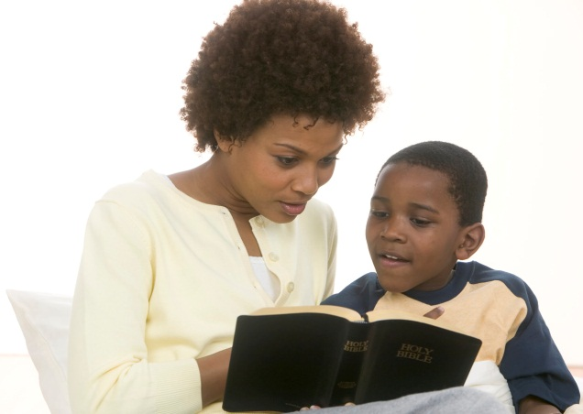


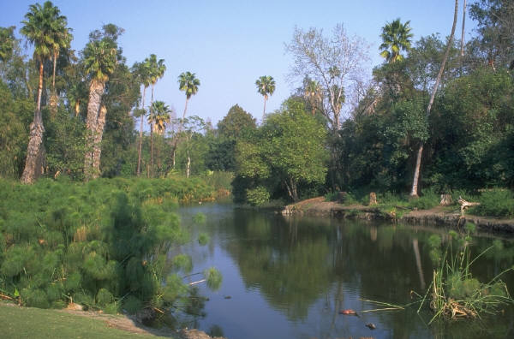

Slide 17
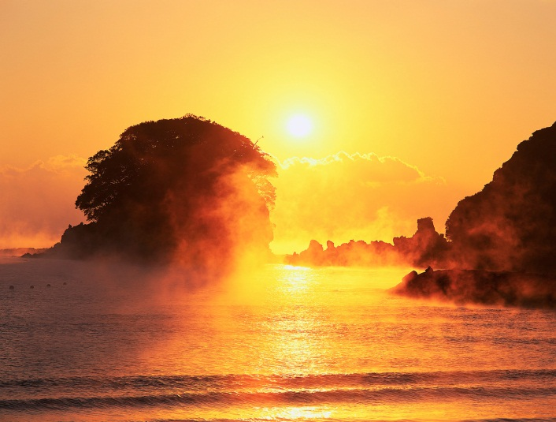
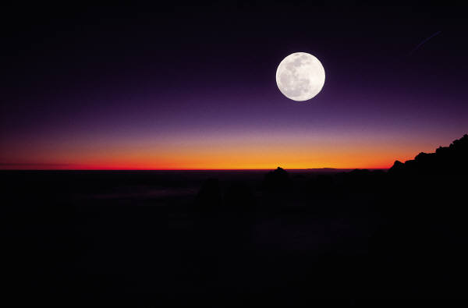
And God said, Let there be lights in the firmament of the heaven to divide the day from the night; and let them be for signs, and for seasons, and for days, and years:
Genesis 1:14

Slide 18
And Moses called all Israel, and said unto them,
Hear, O Israel, the statutes and judgments which I speak in your ears this day, that ye may learn them, and keep, and do them.
Deuteronomy 5:1

Slide 19
And Jesus answered him, The first of all the commandments [is], Hear, O Israel; The Lord our God is one Lord:
Mark 12:29

Slide 20

So then faith [comes] by hearing, and
hearing by the Word of God.
Romans 10:17

Slide 21
To Hear is “Shema”
Shema, is Strong’s #8085,
meaning “to hear, listen and obey.”
According to His Word, physically hearing is NOT enough!

Slide 22
They answered Him and said to Him, “Abraham is our father.”
Jesus said to them, “If you were Abrahams’s children, you would do the works of Abraham. But now you seek to kill Me, a Man who has told
you the truth which I heard
from God. Abraham did not
do this.
You do the deeds of
your father.”

Slide 23
Then they said to Him, “We were not born of fornication; we have one Father-God.” Jesus said to them, “If God were your Father, you would love Me, for I proceeded forth and came from God; nor have I come of Myself, but He sent Me.
Why do you not understand My speech? Because you are not able to listen to My word.
You are of your father the devil, and the desires of your father you want to do.”
John 8: 39-44a

Slide 24
Why do you not understand My speech?
“Speech” is from the Greek word, Strong’s 2981 Lalia
1) speech, i.e a story 2) dialect, mode of speech, pronunciation a) speech which discloses the speaker's native country
Blue Letter Bible. "Dictionary and Word Search for lalia (Strong's 2981)". Blue Letter Bible. 1996-2012. 10 May 2012. < http:// www.blueletterbible.org/lang/lexicon/lexicon.cfm?
strongs=G2981 >

Slide 25
Because you are not able to listen to My Word.
“Word” is from the Greek word,
Strong’s #3059 Logos
1) of speech a) a word, uttered by a living voice, embodies a conception or idea b) what someone has said
1) a word 2) the sayings of God 3) decree, mandate or order 4) of the moral precepts given by God
5) Old Testament prophecy given by the prophets 6) what is declared, a thought, declaration, aphorism, a weighty saying, a dictum, a maxim …

Slide 26
In John, [Logos] denotes the essential Word of God, Jesus Christ,
the personal wisdom and power in union with God, his minister in creation and government of the universe, the cause of all the world's life both physical and ethical,
which for the procurement of man's salvation put on human nature in the person of Jesus the Messiah, the second person in the Godhead,
and shone forth conspicuously from His words and deeds.

Slide 27
Note: A Greek philosopher named Heraclitus
first used the term Logos around 600 B.C. to
designate the divine reason or plan which
coordinates a changing universe.
Blue Letter Bible. "Dictionary and Word Search for logos (Strong's 3056)". Blue Letter Bible. 1996-2012. 10 May 2012. < http:// www.blueletterbible.org/lang/lexicon/lexicon.cfm?
Strongs=G3056&t=KJV >

Slide 28
I and the Father are One
"And this is eternal life, that they may know You, the only true God, and Jesus Christ whom You have sent.
John 17: 3
"For I have given to them the words which You have given Me; and they have received [them], and have known surely that I came forth from You; and they have believed that You sent Me.
John 17:8
"O righteous Father! The world has not known You, but I have known You; and these have known that You sent Me.
John 17: 25

Slide 29
Paul’s Declaration
But this I confess unto thee, that after the way which they call heresy,
so worship I the God of my fathers, believing all things which are written
in the law and in the prophets.
Acts 24:14

Slide 30
Believing Is “Pisteo”
Kittel’s Theological Dictionary of the New Testament and other similar resources are showing more recent research that confirms this word in its proper grammatical meaning should be understood as
NOT only intellectual agreement
But rather obey, comply and trust in an ongoing sense.

Slide 31
Shema and Pisteo
The Hebrew word Shema
to hear, listen and obey
Is consistent with
The Greek word Pisteo
to obey, comply and trust in an ongoing sense.

Slide 32

The grass withers, the flower fades, But the word of our God stands forever.
Isaiah 40:8
But the word of the LORD endures forever." Now this is the word which by the gospel was preached to you.
1 Peter 1:25

Slide 33
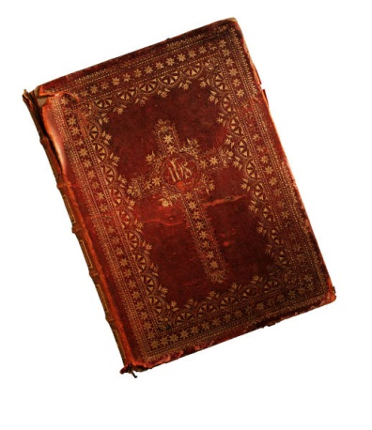
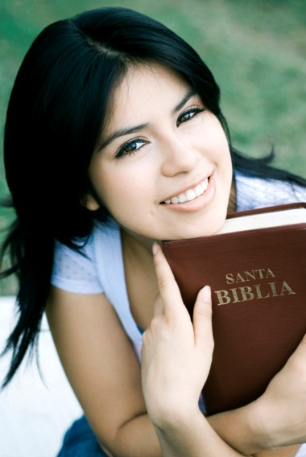
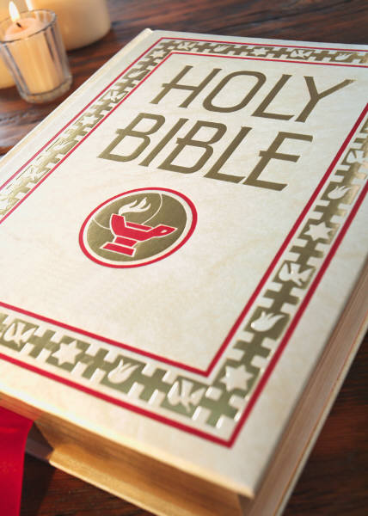
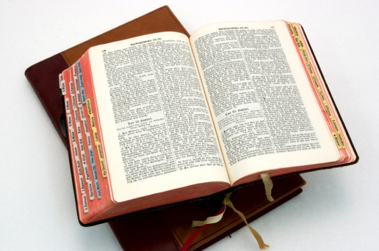
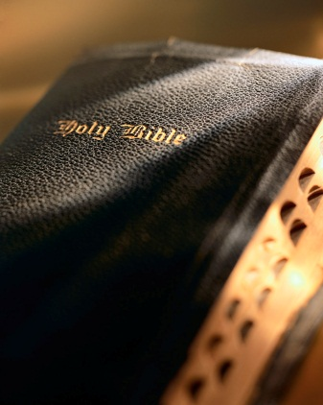
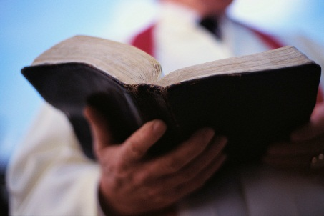
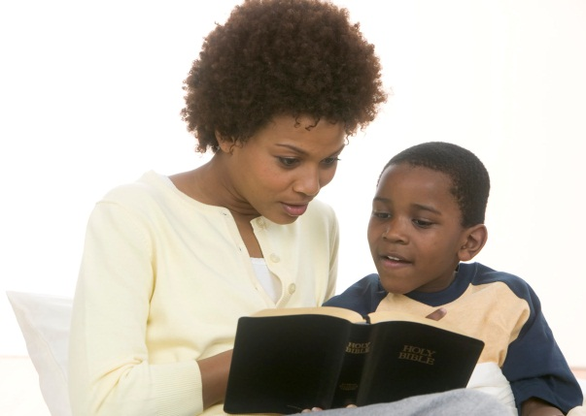

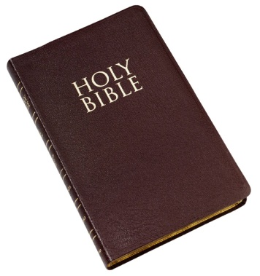
How Many Bibles Do You Own?

Slide 34
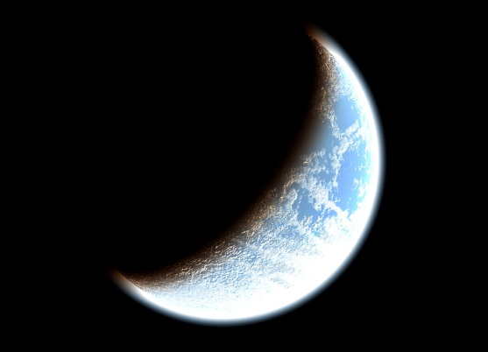
For You will light my lamp;
The LORD my God will
enlighten my darkness.
Psalm 18:28
For you were once darkness, but now [you are] light in the Lord. Walk as children of light.
Ephesians 5:8
But you, brethren, are not in darkness,
so that this Day should overtake you
as a thief.
1 Thessalonians 5: 4 (1-6 for context)

Slide 35
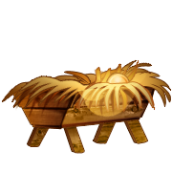
"And I will execute vengeance in anger and wrath On the nations which have not obeyed."
Micah 5:15
~~~~~
For God has not destined us for wrath, but for obtaining salvation through our Lord Jesus Christ,
1 Thessalonians 5:9

Slide 36

"But when these
things begin to
take place, straighten up and lift up
your heads, because your redemption
is drawing near."
Luke 21:28

Slide 37

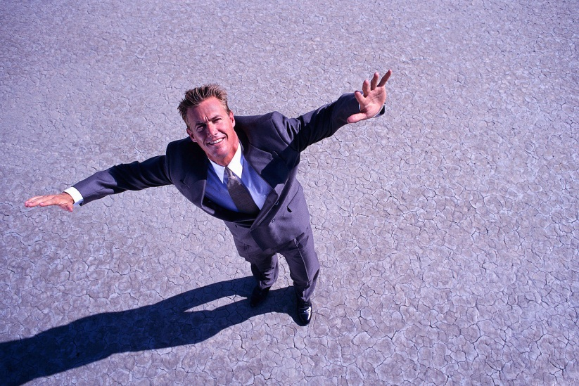
These things are beginning to take place. Look up! Lift up your heads!

Slide 38
For Signs and For Seasons
And God said, Let there be lights in the firmament of the heaven to divide the day from the night; and let them be for signs, and for seasons, and for days, and years:
Genesis 1:14
And there shall be signs in the sun, and in the moon, and in the stars; and upon the earth distress of nations, with perplexity; the sea and the waves roaring;
Luke 21:25
"Watch therefore, and pray always that you may be counted worthy
to escape all these things that will come to pass,
and to stand before the Son of Man.“ Luke 21:36

Slide 39
Disciples Discussed this with Yeshua
And as he sat upon the mount of Olives, the disciples came unto him privately, saying,
Tell us, when shall these things be?
and what [shall be] the sign of thy coming,
and of the end of the world?
Matthew 24:3

Slide 40
Among many details, He said:
Immediately after the tribulation of those days shall the sun be darkened,
and the moon shall not give her light,
and the stars shall fall from heaven,
and the powers of the heavens shall be shaken:
Matthew 24:29

Slide 41
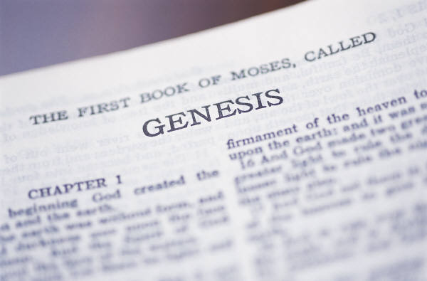
He Gave Us His Calendar
His Word gives us
His plan from the beginning.
The sun, moon and stars
are for the seasons, also understood as
appointed times, or Feasts.
These feasts are pictures of what Messiah would accomplish for His people; from the Passover Lamb to the Return of the King for the Marriage Feast of the Lamb.

Slide 42
Amazing Things Are Happening!
If our Creator intends to fulfill what He has written for us in very literal, physical, and visible ways…
Then the signs in the sun, moon and stars that are happening and will soon happen …
Look like something man could not do and could well indicate the season is upon us.

Slide 43
Look Up, Watch and Pray!
In 2014 and 2015, at the time of both the spring and fall Feasts of the Lord, astronomy software indicates that there will be two sets of blood red moons each year, a tetrad, along with 2 solar eclipses,
and in 2016, at the Day of Trumpets, another eclipse while the moon is not giving its light.
These events match what was foretold.

Slide 44
A TETRAD:
Four Blood Red Moons in 2 Years
The only other tetrads, looking back 500 years, occurred in 1947 and 1967, both times when land was restored to Israel.
Jubilee cycles of years fit the picture.
(See References for Further information)

Slide 45
Lift Up Your Heads! Look Up!
This combination of events
in 2014 and 2015,
on these Feast days,
has never happened before,
and is not ever anticipated to happen again.
Is this significant enough to make you want to know more?

Slide 46
Why does it matter that these events fall on Feast Days?
These [are] the feasts of the LORD, holy convocations which you shall proclaim at their appointed times.
Leviticus 23:4

Slide 47
Behold, I am building a temple for the name of the LORD my God, to dedicate [it] to Him, to burn before Him sweet incense, for the continual showbread, for the burnt offerings morning and evening, on the Sabbaths, on the New Moons,
and on the set feasts of the LORD our God. This [is an ordinance] forever to Israel.
2 Chronicles 2:4

Slide 48
Who IS Israel?
Therefore remember that you, once Gentiles in the flesh—
who are called Uncircumcision by what is called the Circumcision made in the flesh by hands–
that at that time you were without Christ, being aliens from the commonwealth of Israel and strangers from the covenants of promise,
having no hope and without God in the world. …

Slide 49
But now in Christ Jesus you who once were far off have been brought near by the blood of Christ. …
Now, therefore, you are no longer strangers and foreigners, but fellow citizens with the saints and members of the household of God,
Ephesians 2:11-13, 19 (chapter for context)

Slide 50

If you believe in, honor and serve the God of Israel, then you have been grafted in and ARE now part of Israel, the household of God.

Slide 51
Paul’s Words of Admonition
And if some of the branches were broken off, and you, being a wild olive tree, were
grafted in among them,
and with them became a partaker of the root and fatness of the olive tree,
do not boast against the branches. But if you do boast, [remember that]
you do not support the root, but the root [supports] you.
Romans 11:17-18 NKJV

Slide 52
For the hearts of this people have grown dull. [Their] ears are hard of hearing, And their eyes they have closed, Lest they should see with [their] eyes and hear with [their] ears, Lest they should understand with [their] hearts and turn,
So that I should heal them.
Matthew 13:15

Slide 53
In fact, those who resist the Whole Word and do not observe it, and harass those who do, are called arrogant.
You rebuke the arrogant, the cursed, Who wander from Your commandments.
Psalm 119: 21 NASB
The arrogant utterly deride me, Yet I do not turn aside from Your law.
Psalm 119: 51 NASB
The arrogant have dug pits for me, Men who are not in accord with Your law.
Psalm 119: 85 NASB

Slide 54
Appearances Aren’t Always Real
Therefore the Lord said: "Inasmuch as these people draw near with their mouths And honor Me with their lips, But have removed their hearts far from Me, And their fear toward Me is taught by the commandment of men,
Therefore, behold, I will again do a marvelous work Among this people, A marvelous work and a wonder; For the wisdom of their wise [men] shall perish, And the understanding of their prudent [men] shall be hidden."
Isaiah 29: 13-14

Slide 55
Yeshua Messiah Quoted Isaiah
"Hypocrites! Well did Isaiah prophesy about you, saying:
'These people draw near to Me with their mouth, And honor Me with [their] lips, But their heart is far from Me.
And in vain they worship Me, Teaching [as] doctrines the commandments of men.' “
Matthew 14: 7-9

Slide 56
"You have said, 'It is vain to serve God;
and what profit is it that we have kept His charge, and that we have walked in mourning before the LORD of hosts?
'So now we call the arrogant blessed;
not only are the doers of wickedness built up
but they also test God and escape.'"

Slide 57
Then those who feared the LORD
spoke to one another,
and the LORD gave attention and heard it,
and a book of remembrance was written before Him
for those who fear the LORD and who esteem His name.
Malachai 3: 14-16 (whole chapter for context)

Slide 58

"Not everyone who says to Me, 'Lord, Lord,' shall enter the kingdom of heaven, but he who does the will of My Father in heaven.
"Many will say to Me in that day, 'Lord, Lord, have we not prophesied in Your name,
cast out demons in Your name, and
done many wonders in Your Name?’”

Slide 59
And then I will declare to them,
'I never knew you; depart from Me,
you who practice lawlessness!'
Matthew 7:21-23

Slide 60
The Ten Virgins Parable
And while they went to buy, the bridegroom came; and they that were ready went in with him to the marriage: and the door was shut.
Afterward came also the other virgins, saying, Lord, Lord, open to us.
But he answered and said,
Verily I say unto you, I know you not.
Matthew 25:10-12

Slide 61
Two Groups Waiting For Him
Those who are waiting for Him doing what people say is right.
Those who are waiting for Him doing what His Word says is right.

Slide 62
Just “least” or “out” ?
Whoever therefore breaks one of the least of these commandments, and teaches men so, shall be called least in the kingdom of heaven:
but whoever does and teaches [them], he shall be called great in the kingdom of heaven.
Matthew 5:19

Slide 63
Then said the king to the servants, Bind him hand and foot, and take him away, and cast [him] into outer darkness; there shall be weeping and gnashing of teeth.
Matthew 22:13

Slide 64
There shall be weeping and gnashing of teeth, when ye shall see Abraham, and Isaac, and Jacob, and all the prophets, in the kingdom of God,
and you [yourselves] thrust out.
Luke 13:28

Slide 65
The Spirit of the LORD will rest on Him,
The spirit of wisdom and understanding, The spirit of counsel and strength,
The spirit of knowledge and the fear of the LORD.
And He will delight in the fear of the LORD,

Slide 66
And He will not judge by what His eyes see, Nor make a decision by what His ears hear;
But with righteousness He will judge the poor, And decide with fairness for the afflicted of the earth;
And He will strike the earth with the rod of His mouth, And with the breath of His lips He will slay the wicked.
Isaiah 11:2-4

Slide 67
“Vow” comes from “Seven”
"He who has an ear, let him hear what the Spirit says to the churches.
To him who overcomes I will give to eat from the tree of life,
which is in the midst of the Paradise of God." '
Revelation 2:7

Slide 68
Those who know Him and are known by Him, who walk in His ways,
keeping His Torah and His Feasts will have an ear to hear and they will look to the heavens and see the signs of His return,
not being surprised or frightened when the Day of the Lord arrives.

Slide 69
Back to the Garden As A Bride
Those who hear with their ears and obey will have the right to eat from the Tree of Life in the Garden.
There is yet time to be prepared with the Light.

Slide 70
Be Blessed and Strengthened in our Messiah!
Barbara L. Klika, MSW
Undershepherd
Set Apart Ministries, Inc.
P. O. Box 5584
De Pere, WI 54115
(920) 336-7005
info@set-apart-ministries.org
http://www.set-apart-ministries.org

Slide 71
Addendum
*Prophecy/Astronomy Teachings
*Photography of Blood Red Moon eclipse
*Blood Red Moon References
* Set Apart Ministries Related Teachings

Slide 72
Prophecy and Astronomy
Daniel’s Timeline 2001 but did not publically release until 2005 www.danielstimeline.com
Blood Red Moons Pastor Mark Bilitz from 2008 http://www.youtube.com/watch?v=vi78PmRX46Y&feature=related
These two previous teachings use the Hillel II Traditional Feast Days Calendar to establish the Feast Days.
End of Days Series Psalm 119 Ministries- 2010-2012 Release of Findings http://www.testeverything.net
This teaching uses the conjunction and sighting of the New Moon to establish the dates of the Feast Days.

Slide 73
Darkened Sun and Blood Red Moon References
The sun shall be turned into darkness, and the moon into blood,
before the great and the terrible day of the LORD come.
Joel 2:31
The sun shall be turned into darkness, and the moon into blood, before that great and notable day of the Lord come: Acts 2:20
And I beheld when he had opened the sixth seal, and, lo, there was a great earthquake; and the sun became black as sackcloth of hair, and the moon became as blood;
Revelation 6:12

Slide 74
What Does a Blood Red Moon Eclipse look like?
A time lapse photography of a 2010 eclipse is available here:
http://www.youtube.com/watch?v=lcRp1jKJmJU&feature=related

Slide 75
Set Apart Ministries Related Teachings Found Under Menu Tab: Our Teachings
Poor, Blind and Naked from Eden to Laodicea
If You Love Me, Obey My Commands!
A Holiday by Any Other Name Is NOT the Same!
Of Men and Trees
Who Were the “Jews’ & “Gentiles” in Scripture? Generalizations Lead to Polarization
How Can I Tell if My Faith is Love Based or Fear Based?
Chanukah is for Christians

Slide 76
Grateful Thanks
For Blue Letter Bible and resources at www.blueletterbible.com.
(See our Study Resources Page for many additional sources.)
For those who have presented what they are seeing in the Word to help prepare the Body of Messiah.
For our Set Apart Ministries community and our unity in Messiah as we prepare for His return.
For our Abba Who gives me songs in the night.

Slide 77
For More Information
Please contact us at:
Set Apart Ministries, Inc.
P. O. Box 5584
De Pere WI 54115
(920) 336-7005 Info@set-apart-ministries.org

